Slide 1
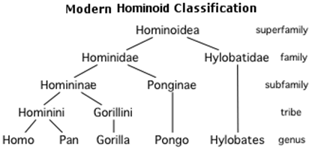
Trees
A data structure for hierarchical data
data stored in nodes (or vertices)
Every node except the root has exactly one parent
root
depth = 0
siblings
child 1
child 2
height
= 3
internal
node
leaf 1
leaf 2
depth = 2
Vocabulary
Root node
Leaf node
Edge
Child/parent
Siblings
Internal node
Ancestor/descendent
Depth of a node
Height of a tree
non-linear!
leaf 3
parent 1
parent 2
illegal
child
<number>
Notes:
<number>

Slide 2
Binary Trees
A binary tree is a tree where each internal node has at most two children
sometimes indicated as left-child and right-child
Implementation:
typedef struct node {
int data; /* or some other type */
struct node *left;
struct node *right;
} tNode;
If an internal node only has one child, left or right will be NULL
for a leaf, left = right = NULL
To access: tNode *root; /* NULL, if tree is empty */
<number>
Notes:
<number>

Slide 3
Creating a node
Suppose we want to create a new node containing some data D
the left child should be the sub-tree L
the right child should be the sub-tree R
L and R could be empty
tNode *makeNode(int D, tNode *L, tNode *R) {
tNode *node = (tNode *) malloc(sizeof(tNode));
if(node == NULL) { return NULL; }
node->data = D;
node->left = L;
node->right = R;
return node;
}
D
L
R
<number>
Notes:
<number>

Slide 4
Question
What kind of a tree does the following code make?
tNode *makeNode(int D, tNode *L, tNode *R) {
/* code from previous slide */
}
void main() {
tNode *n1, *n2, *n3, *n4, *root;
n1 = makeNode(1, NULL, NULL);
n2 = makeNode(2, n1, NULL);
n3 = makeNode(3, NULL, NULL);
n4 = makeNode(4, n3, n2);
root = makeNode(0, NULL, n4);
}
0
4
3
2
1
<number>
Notes:
<number>

Slide 5
Simplified forall function for trees
Suppose we want to print all nodes in a tree:
void forall(tNode *node) {
if(node == NULL) { return; }
printf("%d\n", node->data);
forall(node->left);
forall(node->right);
}
Question 1: What happens on this?
Question 2: How about with this change?
first version: preorder traversal (this, left, right)
second version: inorder traversal (left, this, right)
also: postorder traversal (left, right, this)
0
4
3
2
1
<number>
Notes:
<number>

Slide 6
Simplified forall function for trees
Suppose we want to print all nodes in a tree:
void forall(tNode *node) {
if(node == NULL) { return; }
printf("%d\n", node->data);
forall(node->left);
forall(node->right);
}
Question 1: What happens on this?
Question 2: How about with this change?
first version: preorder traversal (this, left, right)
second version: inorder traversal (left, this, right)
also: postorder traversal (left, right, this)
0
4
3
2
1
<number>
Notes:
<number>

Slide 7
General preorder
tNode *preorder(tNode *node,
int(*task)(int, void*), void*),
void *args) {
if(node == NULL) { return NULL; }
if(!task(node->data, args)) { return node; }
tNode *temp = preorder(node->left, task, args);
if(temp != NULL) { return temp; }
return preorder(node->right, task, args);
}
<number>
Notes:
<number>

Slide 8
Question
What does this function compute?
int strange(tNode *node) {
if(node == NULL) { return 0; }
return strange(node->left)
+ node->data
+ strange(node->right);
}
For the example: 0 + 3 + 4 + 1 + 2
in general, sum of data
Question: The above function uses inorder traversal. What would happen if we used preorder traversal? Postorder?
0
4
3
2
1
<number>
Notes:
<number>

Slide 9
Freeing memory
The following function frees memory used by a tree:
void freeTree(tNode *node) {
if(node == NULL) { return; }
freeTree(node->left);
freeTree(node->right);
free(node);
}
Question: The above function uses postorder traversal. What would happen if we used inorder traversal? Preorder?
4
freeTree(node->left);
free(node);
freeTree(node->right);
3
2
1
<number>
Notes:
<number>

Slide 10
An application: expression trees
Evaluating the tree:
// assume node != NULL
int eval(tNode *node) {
if(isInt(node->data)) {
return toInt(node->data);
}
if(isPlus(node->data)) {
return eval(tNode->left)
+ eval(tNode->right);
}
if(isMult(node->data)) { ... }
if(isUMinus(node->data)) {
return –eval(node->left);
}
// never reach here
}
+
3
*
-
9
1
6
<number>
Notes:
<number>

Slide 11
Ordered Binary Trees
Suppose the data-type used in tree nodes supports ordering
e.g., any two ints can be compared using <
We can then define an ordered binary tree where every node x satisfies this ordering property:
the data at all nodes in x’s left sub-tree is less than or equal to the data at node x
the data at all nodes in x’s right sub-tree is greater than the data at node x
Finding data in a tree
without the ordering property
with the ordering property
2
1
4
3
<number>
Notes:
<number>

Slide 12
Finding data in an ordered tree
This function assumes that node is the root of an ordered tree
int find(tNode *node, int D) {
if(node == NULL) { return 0; }
if(D == node->data) {
return 1;
} else if(D < node->data) {
return find(node->left, D);
} else {
return find(node->right, D);
}
}
2
1
4
3
<number>
Notes:
<number>

Slide 13
Finding data in an ordered tree
This function assumes that node is the root of an ordered tree
int find(tNode *node, int D) {
if(node == NULL) { return 0; }
if(D == node->data) {
return 1;
} else if(D < node->data) {
return find(node->left, D);
} else {
return find(node->right, D);
}
}
2
1
4
3
<number>
Notes:
<number>

Slide 14
Inserting data into an ordered tree
Our ordered tree data structure will not permit duplicate data
can be modified to allow duplicates
tNode *insert(tNode *node, int D) {
if(node == NULL) {
return makeNode(D, NULL, NULL);
}
if(D < node->data) {
node->left =
insert(node->left, D);
} else if(D > node->data) {
node->right =
insert(node->right, D);
}
return node;
}
D
2
0
5
3
<number>
Notes:
<number>

Slide 15
Understanding insert
Draw the tree that will be created
tNode *insert(tNode *node, int D) {
/* code from previous slide */
}
void main() {
tNode* root =
insert(
insert(
insert(NULL, 1),
2),
3);
}
1
2
insert(
insert(
insert(NULL, 2),
3),
1);
2
1
3
3
Question 1: Worst-case running time?
Question 2: What if makeNode fails?
<number>
Notes:
<number>

Slide 16
A better insert
tNode *insert(tNode *node, int D) {
if(find(node, D)) { return NULL; }
tNode *newNode = makeNode(D, NULL, NULL);
if(newNode == NULL) { return NULL; }
return rec_ins(node, newNode);
}
tNode *rec_ins(tNode *node, tNode *newNode) {
if(node == NULL) { return newNode; }
if(newNode->data < node->data) {
node->left = rec_ins(node->left, newNode);
} else if(newNode->data > node->data) {
node->right = rec_ins(node->right, newNode);
}
return node;
}
If newNode is the root of an ordered tree,
will rec_ins merge the two ordered trees?
<number>
Notes:
<number>

Slide 17
Merging two trees
Write a function to merge all nodes from src into dest
tNode *merge(tNode *src, tNode *dest) {
if(src == NULL) { return dest; }
dest = insert(dest, src->data);
dest = merge(src->left, dest);
return merge(src->right, dest);
}
The above code traverses src nodes in preorder
what if we used inorder? Postorder?
If both trees have n nodes initially, how long will merge take?
<number>
Notes:
<number>

Slide 18
Deleting data from an ordered tree
Recall that our ordered trees do not permit duplicates
tNode *delete(tNode *node, int D) {
if(node == NULL) { return NULL; }
if(D < node->data) {
node->left = delete(node->left, D);
} else if(D > node->data) {
node->right = delete(node->right, D);
} else {
tNode *oldNode = node;
node = merge(node->left, node->right);
freeTree(oldNode->left);
free(oldNode);
}
return node;
}
Slow because it:
does not recycle old nodes
wastefully compares data in node->left, node->right subtrees
<number>
Notes:
<number>

Slide 19
What does this code do?
tNode *extractMax(tNode *node, tNode *ans) {
// assume node != NULL
if(node->right == NULL) {
ans->data = node->data;
tNode *temp = node->left;
free(node);
return temp;
}
node->right = extractMax(node->right, ans);
return node;
}
tNode *extractMin(tNode *node, tNode *ans) {
/* similar */
}
<number>
Notes:
<number>

Slide 20
A better delete
tNode *delete(tNode *node, int D) {
if(node == NULL) { return NULL; }
if(D < node->data) {
node->left = delete(node->left, D);
} else if(D > node->data) {
node->right = delete(node->right, D);
} else {
if(node->left != NULL)
node->left = extractMax(node->left, node);
else if(node->right != NULL)
node->right = extractMin(node->right, node);
else { free(node); return NULL; }
}
return node;
}
<number>
Notes:
<number>

Slide 21
Exam 1: Review
Question 1 (4 points): What is the error?
1: void freeList(List list) {
2: Node *this = (Node *) list;
3: if(this != NULL)
4: freeList(this->next);
5: free(this);
6: }
Question 2 (6 points): Worst-case time complexity for size n list:
ListEntry previous(List list, ListEntry e);
ArrayList1
LinkedList 1
Bad typecast?
No base-case?
Type mismatch?
Segmentation fault?
O(1)
O(log n)
O(n)
<number>
Notes:
<number>

Slide 22
Question 3 (10 points)
int sizeOf(DLL_node *node) {
// assume node != NULL;
/* Idea: start from node and go
backwards until NULL, and go
forwards until NULL, counting
as you go
*/
int ans = 1;
for(DLL_node *p=node->prev; p != NULL; p = p->prev)
ans++;
for(DLL_node *p=node->next; p != NULL; p = p->next)
ans++;
return ans;
}
<number>
Notes:
<number>

Slide 23
Question 4 (5+5 points)
int peek(Queue); // returns data at front of queue
first = peek(myQueue);
No way to signal failure on empty queue
int peek(Queue q, int *peeked_value);
if(peek(myQueue, &first)) { ... }
int peek(Queue q, int *error_flag);
first = peek(myQueue, &ok);
if(ok) { ... }
<number>
Notes:
<number>

Slide 24
Balanced Search Trees
How long does it take to determine whether a particular value x appears in an ordered tree T containing n nodes?
Worst case time is O(h), where h is the height of T
Minimum height (T is balanced):
Maximum height (T is lopsided):
Key idea: Keep the tree balanced (prevent it from getting lopsided)
A ≤ ≤ B ≤ ≤ C
h = ⎣log₂ n⎦
h = n − 1
Rotate right
C
Left Left
A
Right Right
Rotate left
A
B
B
C
<number>
Notes:
<number>

Slide 25

Dealing with Left Right and Right Left
Do a double-rotation!
Rotate right
Rotate left
C
C
A
B₂
A
B₁
B₂
C
B₁
B₂
A
B₁
AVL Trees: Ensure that height
difference between left and
right sub-trees is at most 1
<number>
Notes:
<number>

Slide 26
AVL Tree Implementation
typedef struct node {
int data; /* or some other type */
struct node *left;
struct node *right;
int height;
} tNode;
int h(tNode *node) {
return node == NULL ? -1 : node->height;
}
tNode *makeNode(int D, tNode *L, tNode *R) {
tNode *node = (tNode *) malloc(sizeof(tNode));
...
node->height = 1 + MAX(h(L), h(R));
return node;
}
<number>
Notes:
<number>

Slide 27
Insert in an AVL tree
tNode *rec_ins(tNode *node, tNode *newNode) {
if(node == NULL) { return newNode; }
if(newNode->data < node->data) {
node->left = rec_ins(node->left, newNode);
if(h(node->left) > h(node->right)) {
node->height = h(node->left) + 1;
}
} else if(newNode->data > node->data) {
node->right = rec_ins(node->right, newNode);
if(h(node->right) > h(node->left)) {
node->height = h(node->right) + 1;
}
}
return balance(node);
}
tNode *insert(tNode *node, int D) {
if(find(node, D)) { return NULL; }
tNode *newNode = makeNode(D, NULL, NULL);
if(newNode == NULL) { return NULL; }
return rec_ins(node, newNode);
}
<number>
Notes:
<number>

Slide 28
Balancing nodes in an AVL tree
tNode *balance(tNode *node) {
if(node == NULL) { return NULL; }
if(h(node->left) > h(node->right)+1) {
if(h(node->left->left) > h(node->left->right) {
return handleLL(node);
} else {
return handleLR(node);
}
} else if(h(node->right) > h(node->left)+1) {
if(h(node->right->right) > h(node->right->left)) {
return handleRR(node);
} else {
return handleRL(node);
}
} else { return node; }
}
<number>
Notes:
<number>

Slide 29
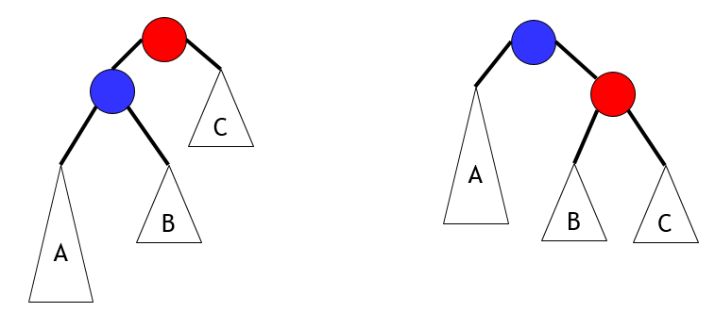
handleLL
tNode *handleLL(tNode *node) {
tNode *A, *B, *C, *result;
result = node->left;
A = result->left;
B = result->right;
C = node->right;
result->right = node;
node->left = B;
node->height = 1 + MAX(h(B), h(C));
result->height = 1 + MAX(h(A), node->height);
return result;
}
O(1) time
Hence, balance() is also O(1) time
Thus, insert is O(h)
We will prove that h is O(log n)
node
result
<number>
Notes:
<number>

Slide 30
Delete in an AVL tree
tNode *delete(tNode *node, int D) {
if(node == NULL) { return NULL; }
if(D < node->data)
node->left = delete(node->left, D);
else if(D > node->data)
node->right = delete(node->right, D);
else {
if(node->left != NULL)
node->left = extractMax(node->left, node);
else if(node->right != NULL)
node->right = extractMin(node->right, node);
else { free(node); return NULL; }
}
node->height = 1 + MAX(h(node->left), h(node->right));
return balance(node);
}
<number>
Notes:
<number>

Slide 31
Space overhead per node
Our AVL tree nodes store the (absolute) height of each node in the tree
typedef struct node {
int data;
struct node *left;
struct node *right;
int height; // sizeof(int) overhead per node
} tNode;
This can be reduced to two bits overhead per node:
LeftHeavy, Balanced, RightHeavy
Slightly more complex insert/delete/balance
another example of the space/time tradeoff!
<number>
Notes:
<number>

Slide 32
AVL trees with n nodes have O(log n) height
Recall: AVL Trees ensure that height difference between left and right sub-trees is at most 1
Let m(h) be the minimum number of nodes in an AVL tree of height h
If an AVL tree with n nodes has height h then n ≥ m(h)
Hence, h ≤ m⁻¹(n) [assuming m is an increasing function]
Now m(0) = 1, m(1) = 2, m(2) = 4, m(3) =
∀h ≥ 2, m(h) = 1 + m(h − 1) + m(h − 2)
F(0) = F(1) = 1; ∀h ≥ 2, F(h) = F(h − 1) + F(h − 2)
Prove that ∀h ≥ 0, m(h) = F(h+2) − 1
1 +
m(2) +
m(1)
= 7
<number>
Notes:
<number>

Slide 33
Critique this “proof”
Given: m(0) = 1, m(1) = 2; ∀h ≥ 2, m(h) = 1 + m(h − 1) + m(h − 2)
and F(0) = F(1) = 1; ∀h ≥ 2, F(h) = F(h − 1) + F(h − 2)
We will prove that ∀h ≥ 0, m(h) = F(h+2) − 1 by induction on h
Base case (h = 0): m(0) = 1 and F(2) = F(0) + F(1) = 1 + 1 = 2
so the base case holds ☺
Inductive step (h > 0): m(h) = 1 + m(h − 1) + m(h − 2)
= 1 + F(h+1) − 1 + F(h) − 1 by the inductive hypothesis
= F(h+2) − 1 by the definition of F
☺
Fails for h = 1
<number>
Notes:
<number>

Slide 34
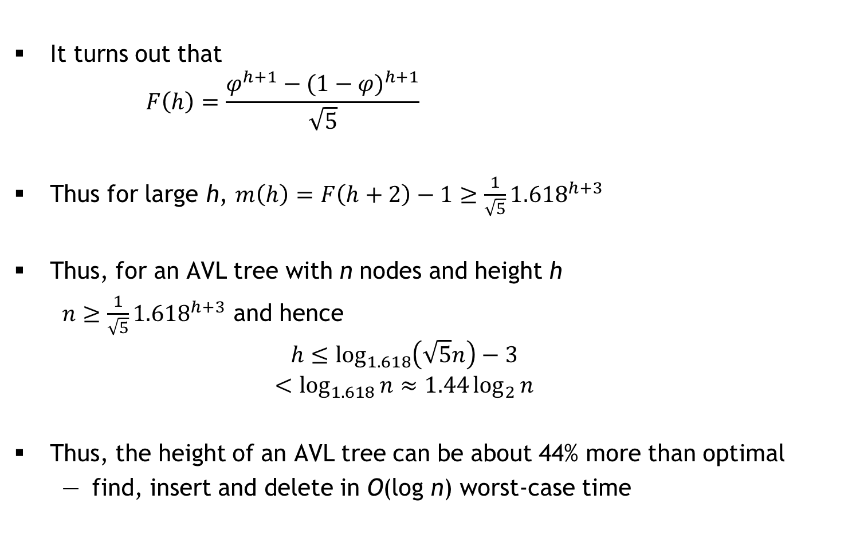
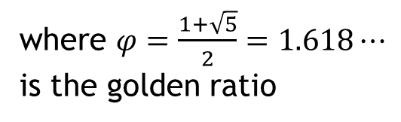
Fibonacci numbers and the Golden Ratio
It turns out that
Thus for large h,
Thus, for an AVL tree with n nodes and height h
and hence
Thus, the height of an AVL tree can be about 44% more than optimal
find, insert and delete in O(log n) worst-case time
where
is the golden ratio
<number>
Notes:
<number>

Slide 35
Dictionary ADT
A dictionary stores (key, value) pairs where keys are totally ordered
e.g., integers, reals, vectors, strings, …
For a key k, a dictionary has at most one pair (k, v)
#ifndef DICT_H
#define DICT_H
typedef void* DictEntry;
void setValue(DictEntry, value_t);
value_t getValue(DictEntry);
typedef void* Dict;
void freeDict(Dict);
int isEmpty(Dict);
int size(Dict);
Dict insert(Dict, key_t, value_t);
DictEntry get(Dict, key_t);
Dict delete(Dict, key_t);
DictEntry forall(Dict, int(*task)(int, void*), void*);
#endif
int cmp(key_t, key_t)
Assuming cmp runs
in O(1) time!
Linked list | AVL tree
O(1) | O(1)
O(n) | O(n)
O(n) | O(log n)
Replace old value if
key already exists
<number>
Notes:
<number>

Slide 36
Research Note
A comparison of dictionary implementations by Mark Neyer, 2009
This paper explores several implementations of dictionaries:
hash tables, Red-Black Trees, AVL Trees, and Skip Lists
The Microsoft .NET platform was chosen for this experiment because it is of interest to the author’s experience in industry, and due to the availability of a precise memory measurement debugging library, namely sos.dll
Implementations
System.Collections.hashtable
AVL tree implementation: www.vcskicks.com
Red-Black tree implementation: www.devx.com/DevX/Article/36196
Skip List implementation: www.codeproject.com/KB/recipes/ skiplist1.aspx
No mention of hardware!
<number>
Notes:
<number>

Slide 37
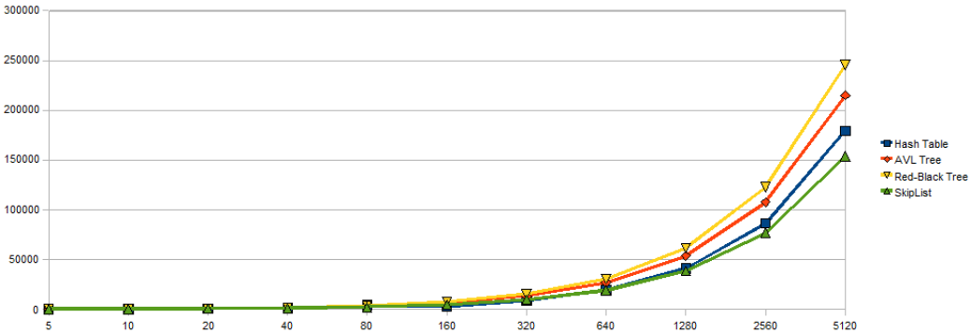
Results (1/3)
Size (in bytes) vs. n
<number>
Notes:
<number>

Slide 38
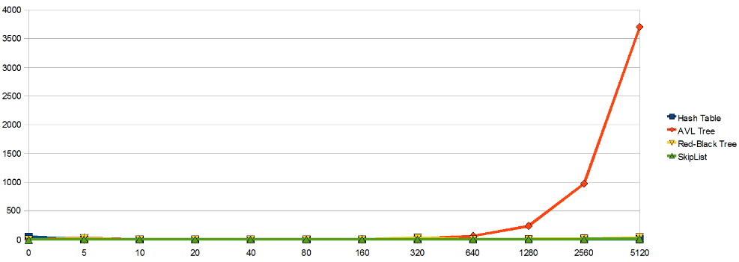
Results (2/3)
Creation time (in milliseconds) vs. n
<number>
Notes:
<number>

Slide 39
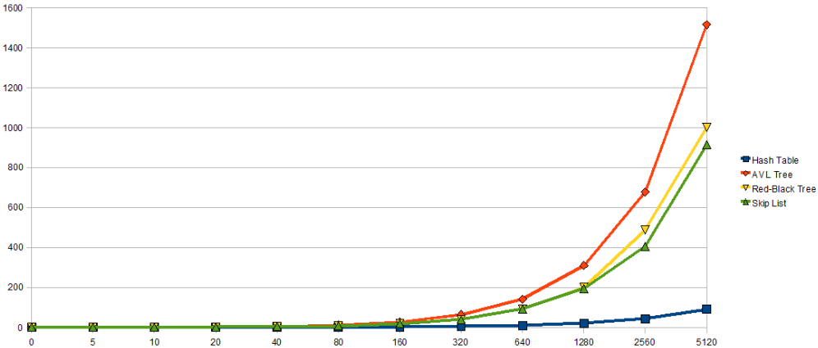
Results (3/3)
Query time for 100n keys (in milliseconds) vs. n
<number>
Notes:
<number>

Slide 40
Priority Queues
A priority queue is an ADT for storing (priority, data) pairs, where priorities are totally ordered (e.g., integers, strings, etc.)
Two variants (silly English):
low-magnitude priority means “high priority”
high-magnitude priority means “high priority”
#ifndef PQUEUE_H
#define PQUEUE_H
typedef void* PQEntry;
typedef void* PQueue;
int size(PQueue);
PQEntry insert(PQueue *pq, int priority, int data);
int deleteNext(PQueue pq, int *priority, int *data);
PQEntry update(PQueue pq, PQEntry e, int newPriority);
#endif
<number>
Notes:
<number>

Slide 41
Priority Queue Implementations
Interview question: All n (priority, data) items known in advance, only need deleteNext. What is the best implementation?
AVL trees: pointer-based, large constant hidden in the O(.)
We will develop a fast, array-based implementation
size in O(1) time
insert and deleteNext in O(log n) time [smaller constant]
 | Linked List | Ordered Linked List | Ordered Binary Tree | Balanced Ordered Binary Tree
size | O(1) | O(1) | O(1) | O(1)
insert | O(1) | O(n)
deleteNext | O(n) | O(1)
update
O(n)
O(log n)
O(n)
O(log n)
O(1)
O(n)
O(n)
O(log n)
<number>
Notes:
<number>

Slide 42
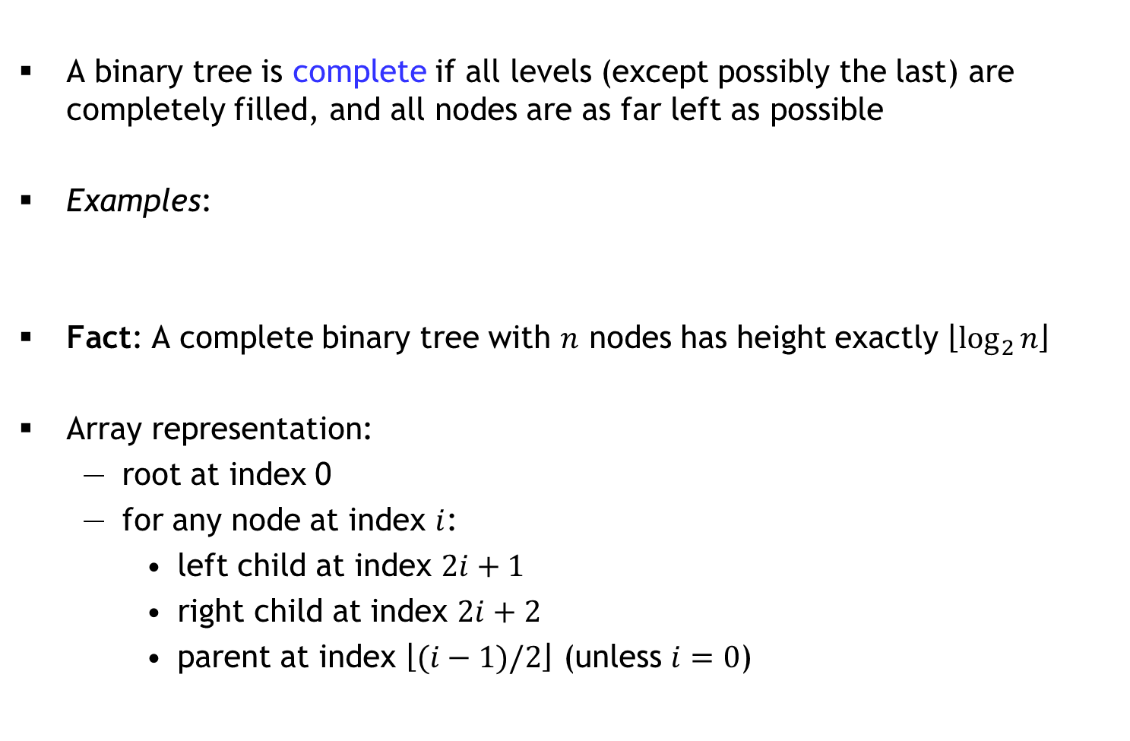
Complete Binary Trees
A binary tree is complete if all levels (except possibly the last) are completely filled, and all nodes are as far left as possible
Examples:
Fact: A complete binary tree with nodes has height exactly
Array representation:
root at index 0
for any node at index :
left child at index
right child at index
parent at index (unless )
<number>
Notes:
<number>

Slide 43
Heaps
Definition:
A minheap is a complete binary tree in which every node’s priority is less than or equal to the priority of its children (min. at root)
A maxheap is a complete binary tree in which every node’s priority is greater than or equal to the priority of its children (max. at root)
We implement a heap as an array
Question: Which of these arrays represent minheaps?
A
1 | 2 | 3 | 4 | 5 | 6
B
1 | 2 | 4 | 5 | 6 | 3
C
1 | 3 | 4 | 2 | 6 | 5
D
1 | 4 | 2 | 6 | 5 | 3
<number>
Notes:
<number>

Slide 44
Sift Up
Suppose the heap is implemented as a struct with array a[] where each array is a struct with priority p and data d
void siftUp(Heap *H, int i) { // minheap
while(i > 0) {
int j = (i-1)/2; // parent
if(H->a[i].p >= H->a[j].p) { return; }
SWAP(H->a, i, j);
i = j;
}
}
What does siftUp(H, 3) do if H->a =
Insert = append to array + sift up the last element: O(log n) time
Why not: SWAP(H->a[i], H->a[j])
Temporary?
1 | 3 | 4 | 2 | 6 | 5
<number>
Notes:
<number>

Slide 45
Sift Up
Suppose the heap is implemented as a struct with array a[] where each array is a struct with priority p and data d
void siftUp(Heap *H, int i) { // minheap
while(i > 0) {
int j = (i-1)/2; // parent
if(H->a[i].p >= H->a[j].p) { return; }
SWAP(H->a, i, j);
i = j;
}
}
Insert = append to array + sift up the last element: O(log n) time
Time to “heapify” n items: O(n log n)
<number>
Notes:
<number>

Slide 46
Sift Down
void siftDown(Heap *H, int i) { // minheap
while(i < (H->size)/2) { // i >= size/2 is leaf!
int j = 2*i+1; // left child
if(j < H->size-1 && H->a[j].p > H->a[j+1].p)
j++; // right child
if(H->a[i].p <= H->a[j].p) { return; }
SWAP(H->a, i, j);
i = j;
}
}
What does siftDown(H, 0) do if H->a =
deleteNext = swap root with last, size--, siftDown(0): O(log n) time
update?
7 | 2 | 4 | 3 | 6 | 5
<number>
Notes:
<number>

Slide 47
Heapify in O(n) time
void heapify(Heap *H) { // minheap
for(int i = H->size/2-1; i >= 0; i--) {
siftDown(H, i);
}
}
Runtime analysis: O(n) iterations, each takes O(log n) time: O(n log n)
Careful runtime analysis?
Heapsort
Two advanced data structures: Treaps and Fibonacci heaps
Sloppy
<number>
Notes:
<number>

Slide 48


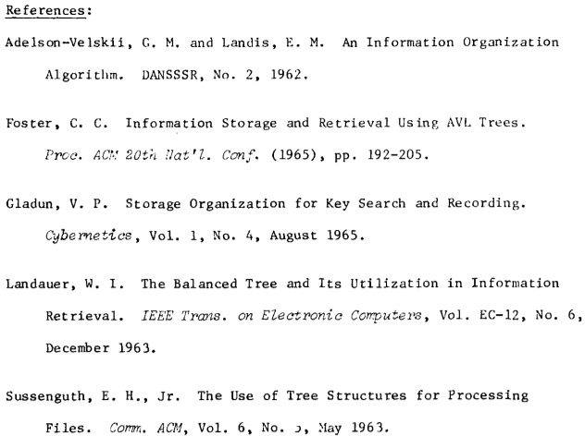

B-trees
Actually in 1970
<number>
Notes:
<number>

Slide 49
Large amount of data
Need to store most of the data on disk (or in the cloud)
getting data from these sources is MUCH slower than RAM
Key idea: If we have to go to the disk, make it count!
each disk access fetches a whole block of data (a few KB)
Component | Latency | Adjusted
1 CPU cycle | 0.3 ns | 1 second
L1 cache access | 0.9 ns | 3 seconds
L2 cache access | 2.8 ns | 9 seconds
L3 cache access | 12.9 ns | 43 seconds
RAM access | 120 ns | 6 minutes
SSD access | 50-150 μs | 2-6 days
HDD access | 1-10 ms | 1-12 months
SF to NYC internet | 40 ms | 4 years
Data from 2014
<number>
Notes:
<number>

Slide 50
Nodes in a B-tree
In a B-tree of order m, each node has up to m children
The root is either a leaf, or has at least two children
Each internal node except the root has between ⎡m/2⎤ and m children
All leaves are at the same level
tree height is ≈ log_{m} n
m is of the order of 10² or more, so for n ≈ 10⁹, depth is around 5
d₁ | d₂ | … | d_{m−1}
m chosen so that
m − 1 data elements
+ m “pointers” fill a
disk block
< d₁
(d₁, d₂)
> d_{m−1}
<number>
Notes:
<number>

Slide 51
Operations on B-trees
Find is a generalization of Find for ordered binary trees
binary search used to find the correct pointer to follow
To insert d, find the leaf node where it should have been
insert into that node (in sorted order)
if the node was full (i.e., it had m − 1 elements), promote the middle element to the parent-level and split this into two half-filled nodes
promote/split may cascade up to the root (tree height will grow)
Delete is similar: remove data, then try to compress with adjacent sibling
d₁ | d₂ | … | d_{m−1}
< d₁
(d₁, d₂)
> d_{m−1}
<number>
Notes:
<number>

Slide 52
An optimization: B⁺ trees
Suppose data is made up of (small) keys and (large) values
search done on the basis of keys
Internal nodes only store keys
values are stored only at leaves
Thus, a single disk block can accommodate many more keys
bushier tree ⇒ shallower tree
Insert animation from OpenDSA
<number>
Notes:
<number>

Slide 53
B/B⁺ trees: Frequent nodes
In both B-trees and B⁺-trees, the root is processed frequently
While the data structure is needed, the root can be stored in RAM
the root can be written out to the disk when the data structure is no longer needed by the program (e.g., when the program terminates)
RAM is large enough to accommodate more than just the root
but it cannot accommodate everything
Note: This is exactly the problem of caching
cache faster than RAM (just like RAM faster than disk)
cache smaller than RAM (just like RAM smaller than disk)
Key Question: What to save and what to evict?
<number>
Notes:
<number>

Slide 54
Eviction Strategies
FIFO: First In First Out
data structure?
LRU: Least Recently Used
data structure?
FF: Furthest in Future
provably optimal
data structure?
Aside: Splay trees
whenever you insert or find something, splay it to the top
O(log n) amortized find/insert/delete
<number>
Notes:
<number>

Slide 55
Questions
In a full tree, every node has either 0 or 2 children
What is the maximum height of a full tree with n nodes
Given pointers p and q to two nodes in an balanced binary search tree (ordered binary tree) with n nodes, describe a fast algorithm to find the lowest common ancestor of p and q
Answer the same question, assuming that the tree is unordered and not necessarily balanced
In a general tree, nodes can have an arbitrary number of children
Describe a space-efficient way to implement general trees in C
<number>
Notes:
<number>

